Slide 1

Multi-zone buildings with hydronic systems models
Valentin Gavan | ENGIE Lab CRIGEN, France

Slide 2
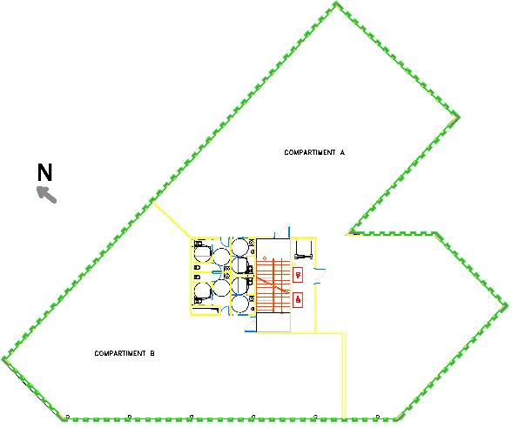
Office building
Real office-building of 3 500 m², 5 floors, 7 zones (4 heated, 3 unheated)
Heating / cooling demand model:
Geometry, building envelope materials, schedules
Controls with PI for each zone
Systems :
BoilerPolynomial + MicroCHP + StratifiedEnhanced + Pumps + Junctions
RadiatorEN442_2 with TwoWayLinear valve for each zone (ON/OFF=f(T_zone))
Boiler & CHP → (ON/OFF=f(T_tank)
Dymola + Buildings.Rooms.MixedAir + Schedules models
Leo J., et al. Assessment of an internal combustion engine micro-CHP operation for different office buildings performance scenarios. Building Simulation 2018
Notes:
37674 sf
8 thermal zones with 3 types of use : offices, welcome and technical areas
Occupancy schedules drive setpoints, ventilation and internal loads (occupant, lighting, computers)
Envelope performance variations for different construction vintage (<‘80, 80-99, 00-11, 2012)

Slide 3
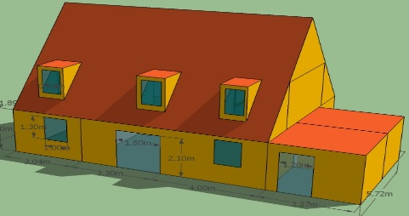
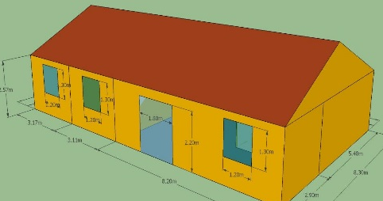
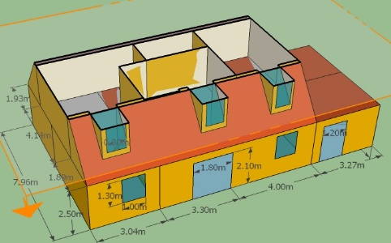
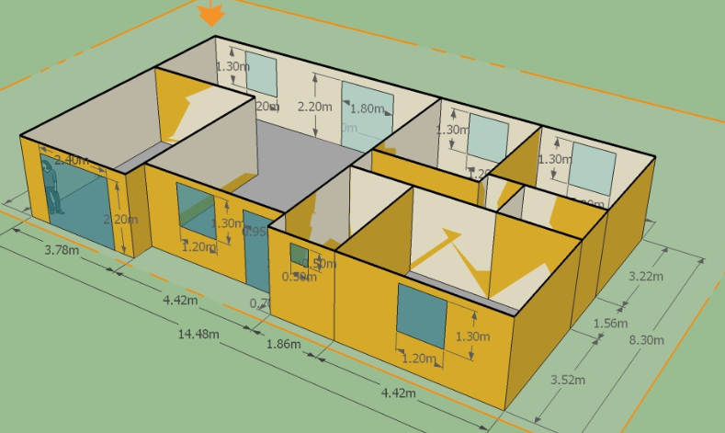
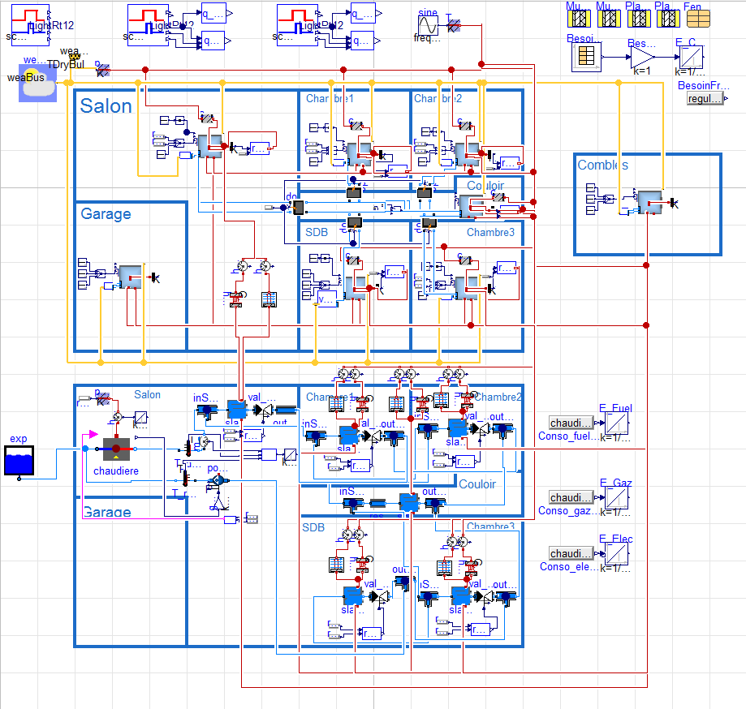
Residential building
Detached house :
95 m², 8 zones (6 heated, 2 unheated)
120 m², 9 zones (7 heated, 2 unheated)
Heating / cooling demand model:
Geometry, building envelope materials, schedules
Controls with PI for each zone
Systems :
BoilerPolynomial + Pump + Junctions +
RadiatorEN442_2 (60/45°C) with TwoWayLinear valve (y=f(T_zone)) for each zone
or RadiantSlabs (27/24°C)
or Radiator + Split
Power modulation of the boiler : f(T_hall)
Dymola + Buildings.Rooms.MixedAir + Schedules models

